Slide 1

Resume classification
BY GROUP 2

Slide 2
Project member
Sr.No | Name | Contact | Email
1. | MR ADITYA DHARMRAJ AWAD | 9322113308 | adityaawad2003@gmail.com
2. | MR THRIPURAM BALARAMA KRISHNA | 9390404413 | tbalaram152000@gmail.com
3. | Ms. Anuja Ananda Sasane | 7410733842 | anujabagadi@gmail.com
4. | Miss Suchetha D H | 9980951180 | suchethadh1234@gmail.com
Project Mentor
Mr. Karthick.

Slide 3

AGENDA
INTRODUCTION
Definition
Purpose
Significance
challenges

Slide 4
BUSINESS OBJECTIVE
The document classification solution should significantly reduce the manual human effort in the HRM. It should achieve a higher level of accuracy and automation with minimal human intervention
Abstract:
A resume is a brief summary of your skills and experience. Companies recruiters and HR teams have a tough time scanning thousands of qualified resumes. Spending too many labor hours segregating candidates resume's manually is a waste of a company's time, money, and productivity. Recruiters, therefore, use resume classification in order to streamline the resume and applicant screening process. NLP technology allows recruiters to electronically gather, store, and organize large quantities of resumes. Once acquired, the resume data can be easily searched through and analyzed.
Resumes are an ideal example of unstructured data. Since there is no widely accepted resume layout, each resume may have its own style of formatting, different text blocks and different category titles. Building a resume classification and gathering text from it is no easy task as there are so many kinds of layouts of resumes that you could imagine.

Slide 5

introduction

Slide 6

Definition:-
Purpose:-
Significance:-
Resume classification refers to the systematic process of categorizing resumes based on specific criteria such as skills, experience, education and qualification
The primary of resume classification is to efficiently manage to influx the job applications, enabling recruiters to identify and prioritize candidates who closely match the requirements of the job role
Resume classification plays a pivotal role in enhancing the efficiency of the recruitment process by reducing manual efforts, accelerating candidates selection, and improving overall hiring

Slide 7
Data Collection and Preprocessing
Data Collection
Resume data was collected from various job search websites and professional networking platforms.
A doc2txt was used to extract resumes in different formats (PDF, Word, plain text) from these sources.
Data Cleaning
The collected resumes underwent a series of preprocessing steps to ensure data quality and consistency.
Common cleaning techniques like removing special characters, stopwords, and punctuation were applied.
Text normalization techniques such as stemming and lemmatization were used to standardize the data.

Slide 8
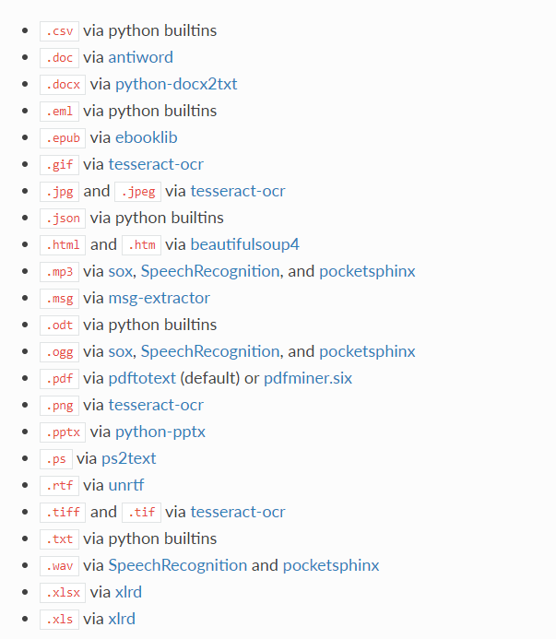
TEXTRACT This package provides a single interface for extracting content from any type of file, without any irrelevant markup.

Slide 9
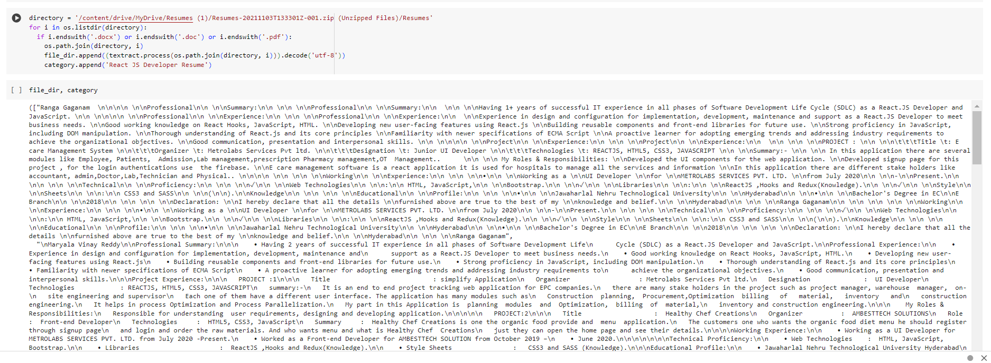
Converting all file to .txt (Process)

Slide 10
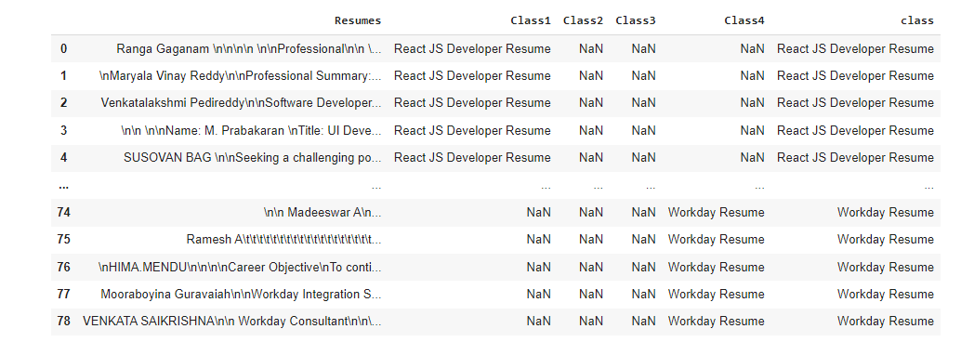
Merging all category files.

Slide 11
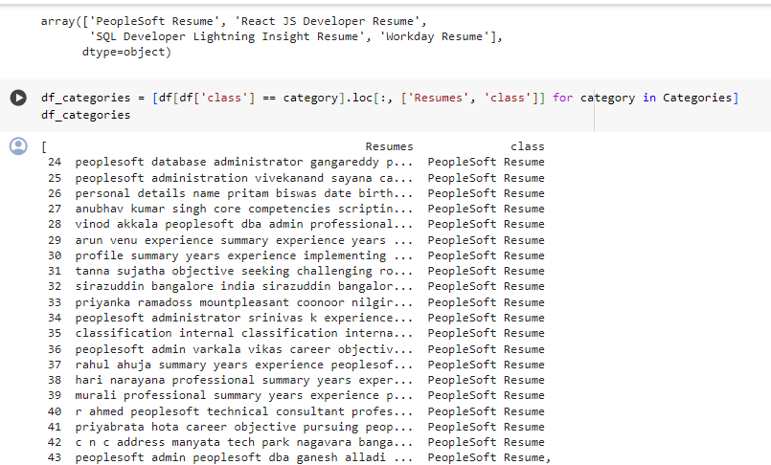
Converting text to .csv (Process)

Slide 12
EDA
Exploratory Data Analysis (EDA) is an analysis approach that identifies general patterns in the data. These patterns include outliers and features of the data that might be unexpected. EDA is an important first step in any data analysis.

Slide 13
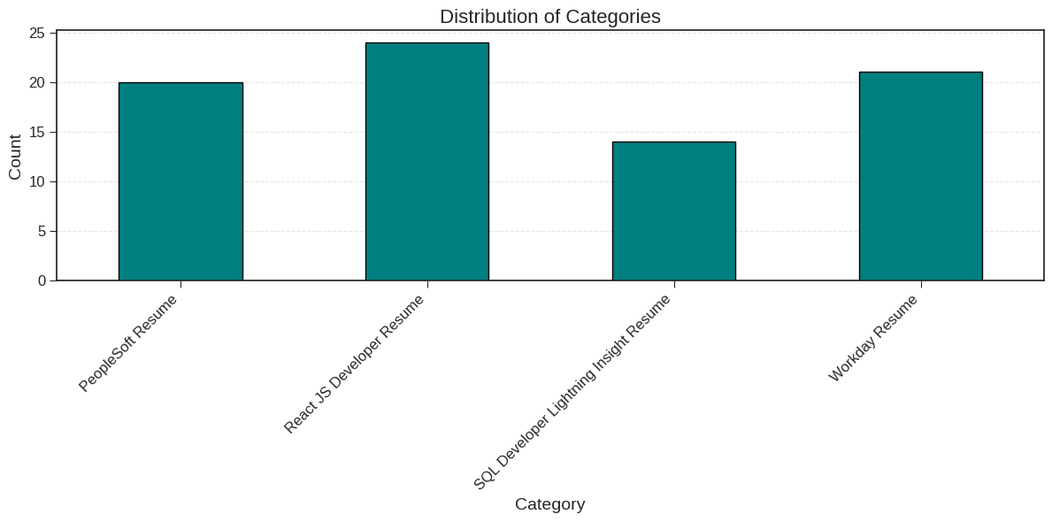
ENGAGING THE AUDIENCE
Insights
The most common category in the resume dataset is React JS development, followed by workday resume.
People soft are also popular categories, while Sql developer has the lowest count.

Slide 14

Resume classification in data science involves categorizing resumes into predefined classes or categories based on specific criteria. This task is often performed in recruitment processes to automate resume screening and identify candidates who best match job requirements. Here are some common strategies used for resume classification in data science:

Slide 15
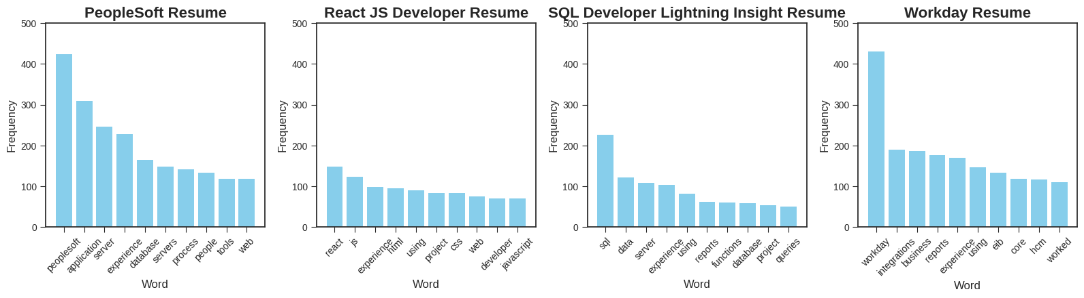
Resume by skills

Slide 16
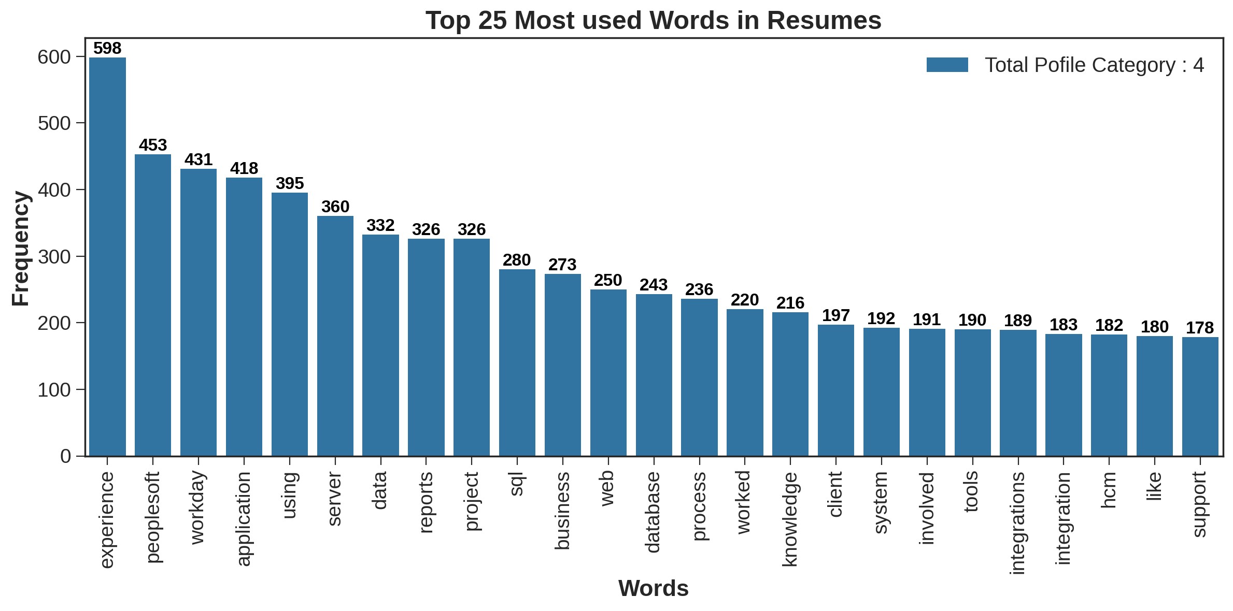
Keyword Matching:
Identify keywords and phrases relevant to the job description and required skills.
Use natural language processing (NLP) techniques to tokenize and process resume text.
Assign scores or weights to each keyword based on importance.
Classify resumes based on the presence or frequency of relevant keywords.

Slide 17
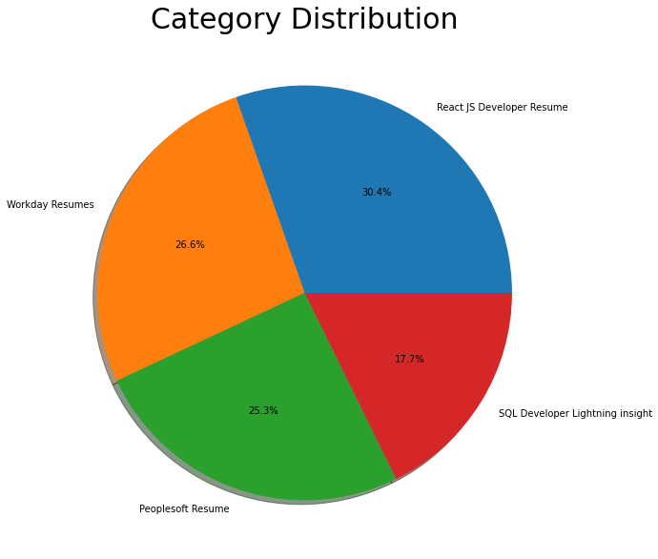
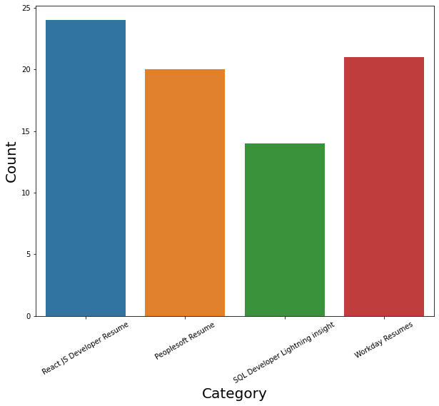
LABLES
By using Pie chart roles applied feature is displayed to visualize the job roles.
By using Histogram roles applied feature is displayed to check the job types.

Slide 18
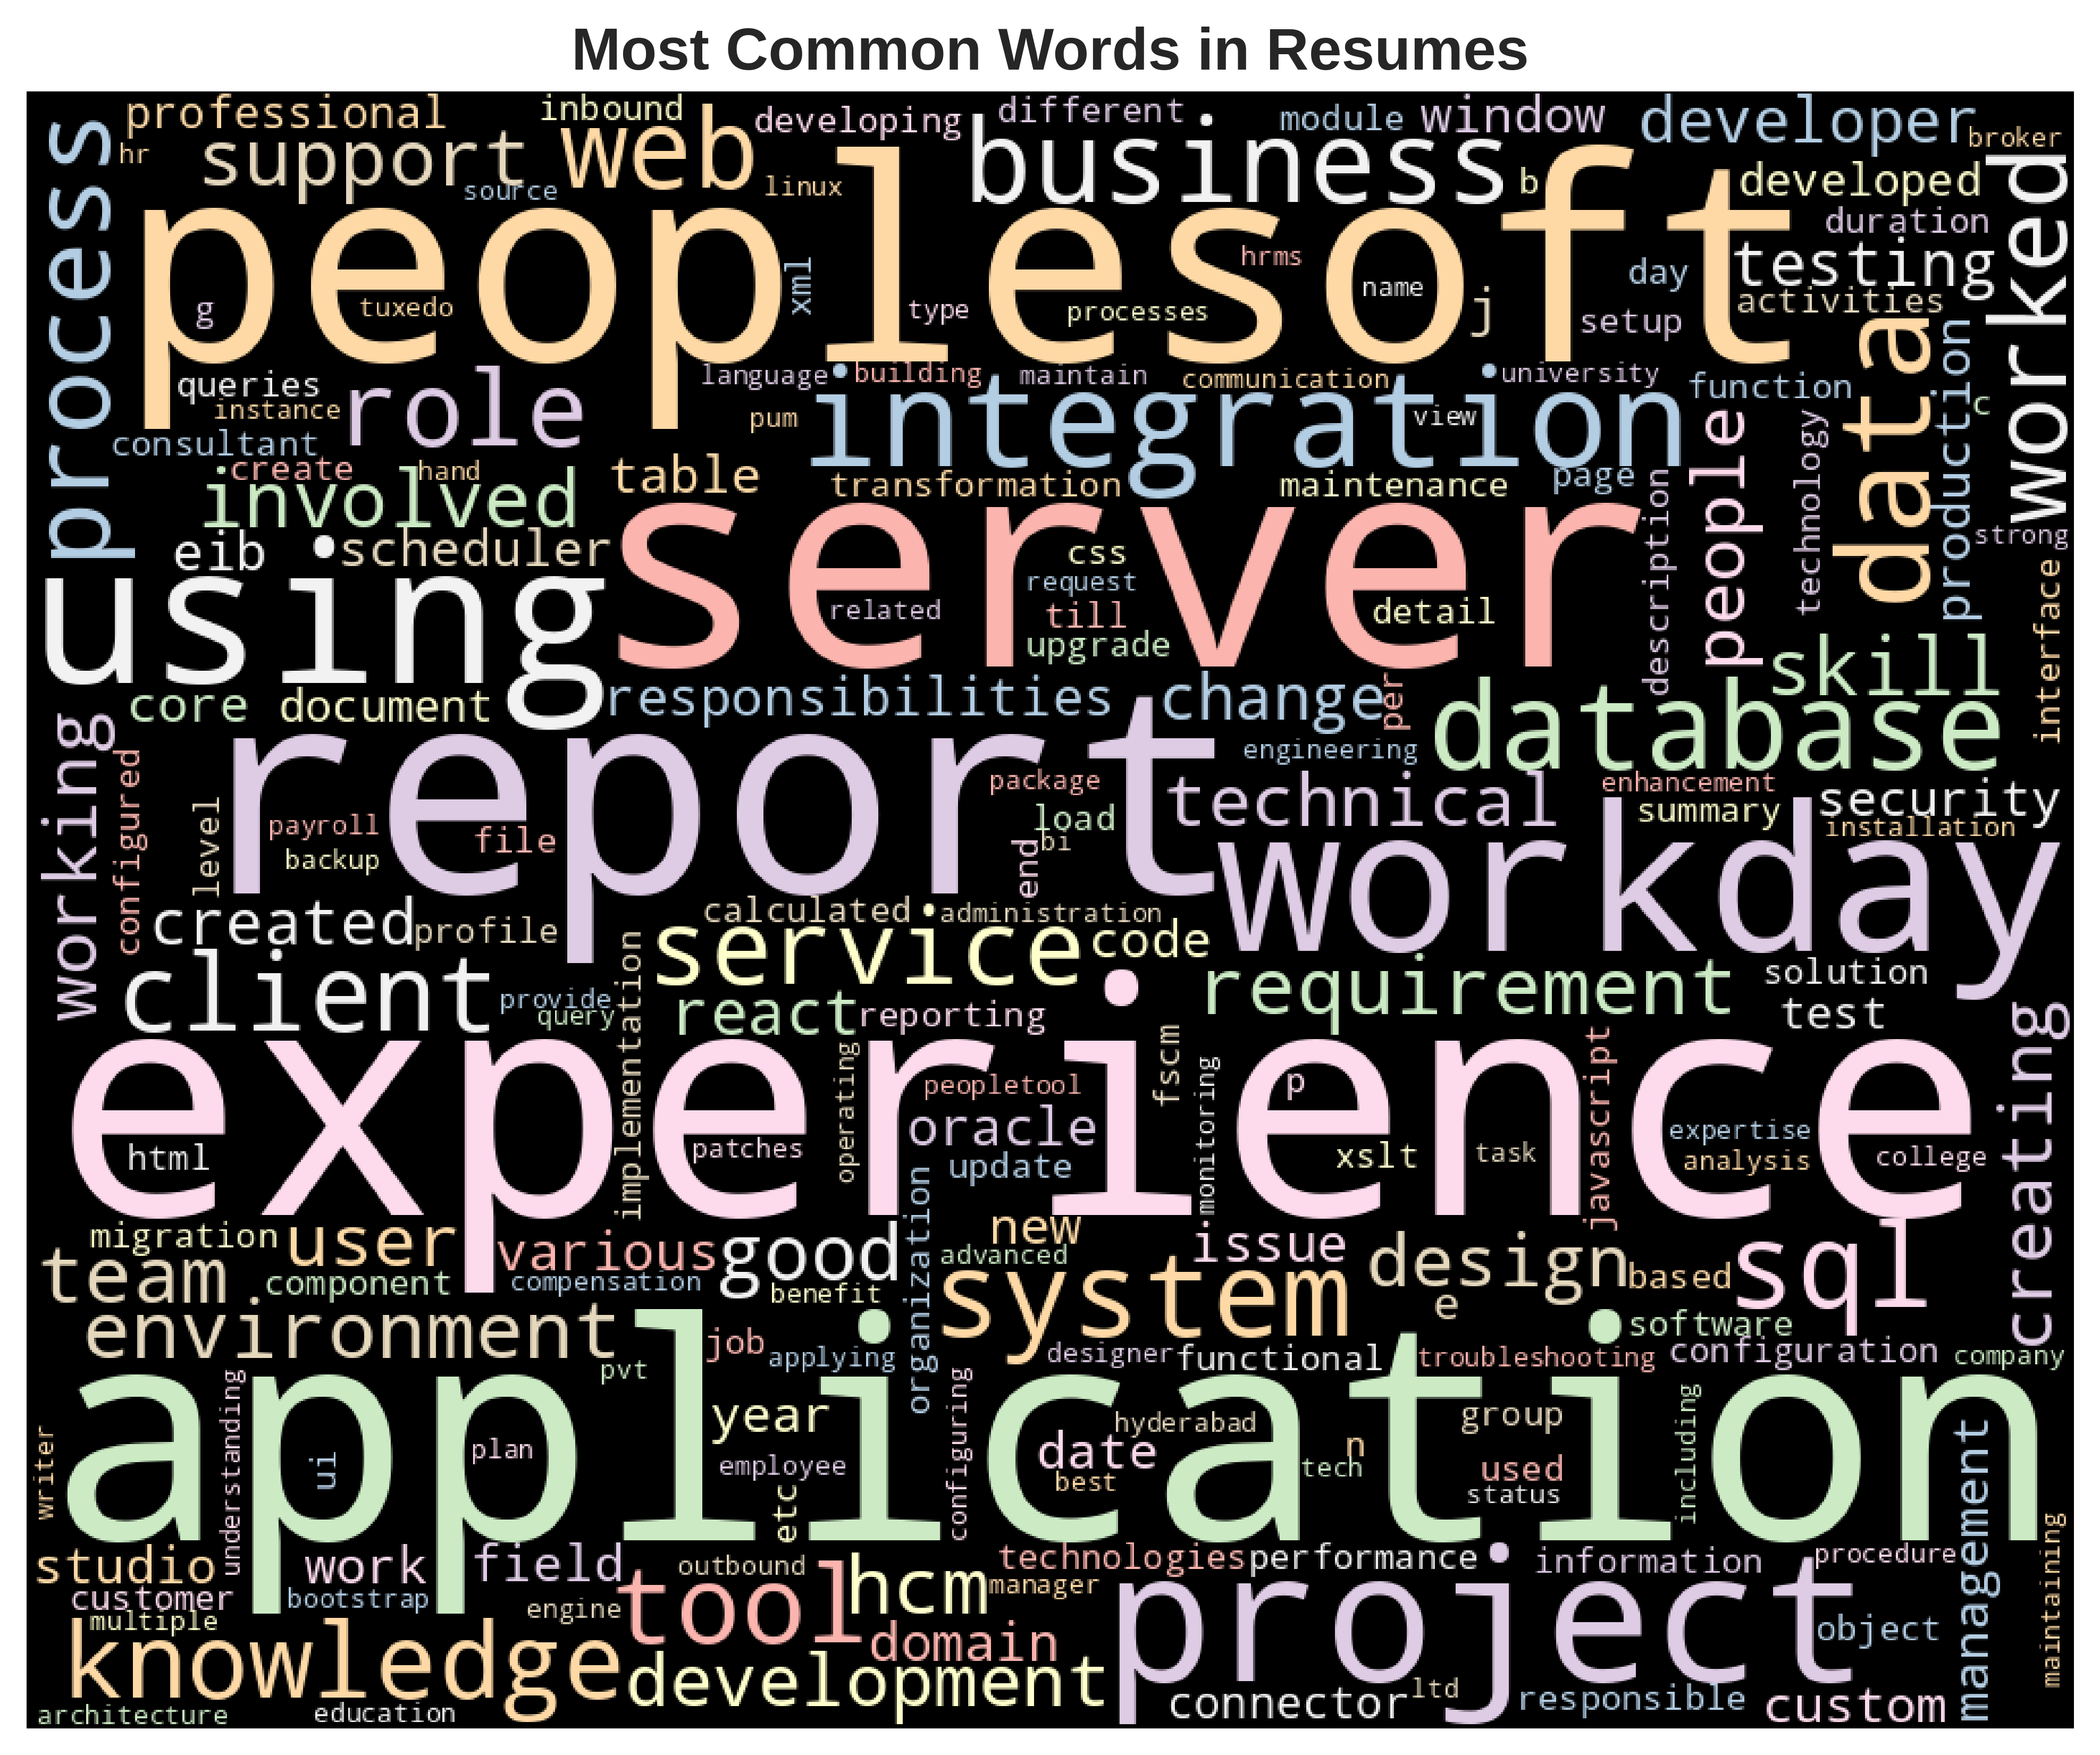

Slide 19
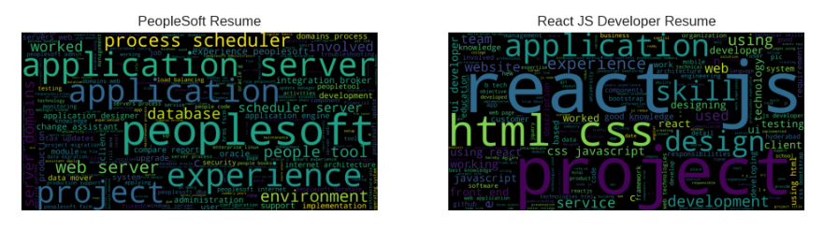
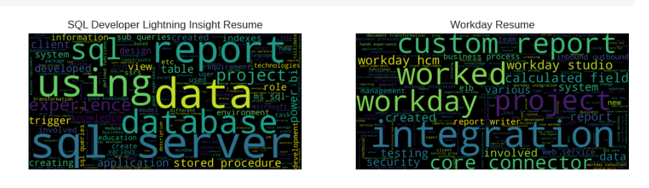

Slide 20
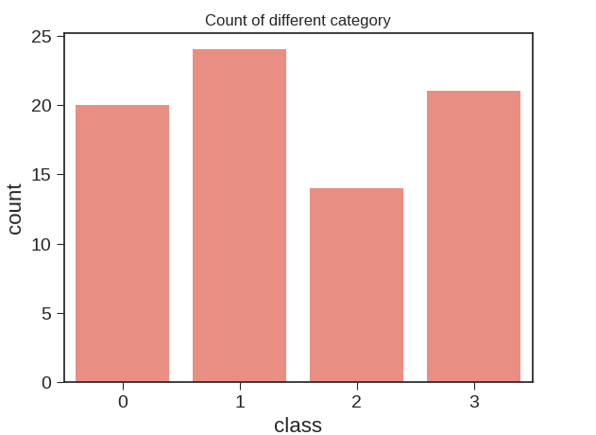

Slide 21
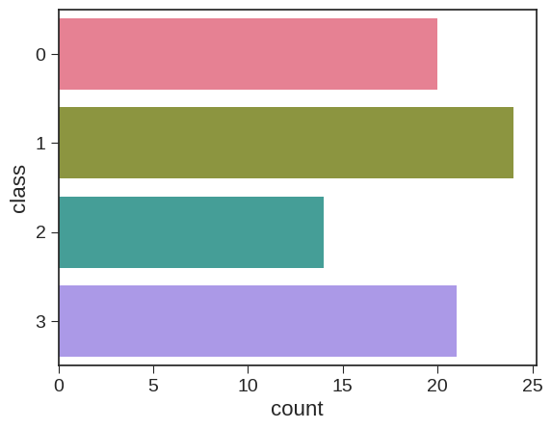

Slide 22
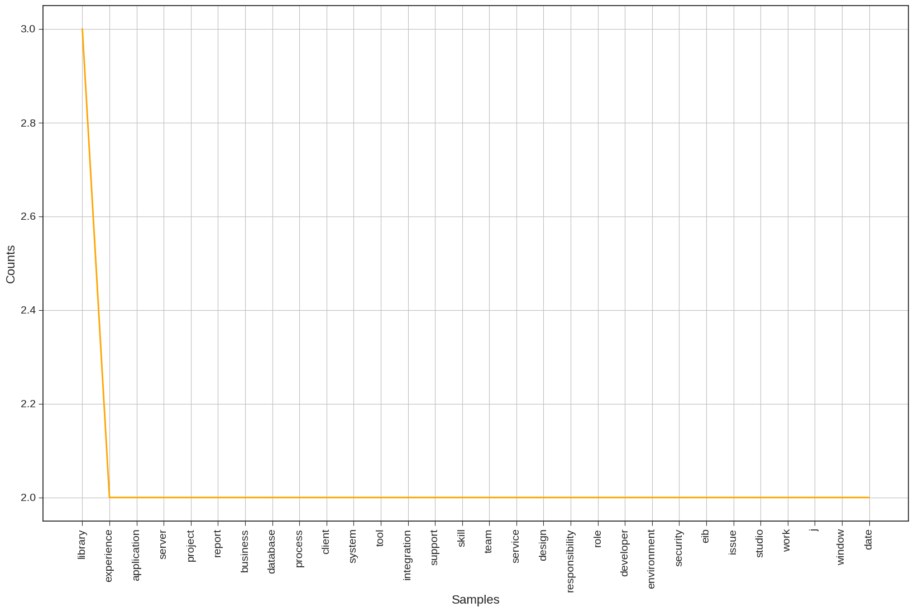

Slide 23
Challenges Faced

Slide 24
Data quality: Resume come in various formats, structures, and qualities. Some may be well-formatted with clear sections like education, experience, and skills, while others may be less organized or contain errors.
Class Imbalance: Depending on the job categories or classes trying to classify resume into, there might be an imbalance in the number or resume belonging to each class. This can lead to biased model that perform poorly on minority classes.
Feature Engineering: Identifying relevant features from resume that effectively differentiate between classes can be challenging. Resumes contain diverse information, including skills, experience, education, and more, and determining which features are most informative can be non-trivial.
Model Selection and Tuning: Choosing the model architecture and hyperparameters for your classification task can significantly impact performance. Moreover, training complex models may require substantial computational resources.

Slide 25
METHODOLOGY
Clearly define the problem trying to solve. In case, it would be classifying resumes into different categories or classes based on certain criteria(e.g, job roles , skill, experience levels).
Gather a diverse set of resumes that represent the different categories you want to classify. Ensure the data is labeled with the correct categories or classes.
Clean the data by removing irrelevant information (e.g, personal details, formatting). Tokenize the text( splitting it into individual wors or phrases).Handel missing data if any.
Extract relevant features from the resume text that can help differentiate between categories. This might include techniques like TF-IDF(Term frequency-inverse Document Frequency), word embeddings( e.g, word2Vec, GloVe), or more advanced techniques like BERT embeddings.

Slide 26
CONCLUSION
Briefly restate the main objectives of the project, such as automating resume screening to streamline the hiring process or improving the accuracy of candidate matching . Recap the methodologies and techniques used in the project, such as natural language processing(NLP) for text analysis , machine learning algorithms like SVM or neural network, Summarize the result obtained from the model metrics. Highlight any significant improvements achieved compared to baseline or previous method. Discuss any insights gained from the analysis. This could include understanding which features or keywords are most indicative of certain job categories, identifying common patterns successful resume, or discovering challenges or biases in data.

Slide 27
Thank you
GROUP 2

